Slide 1

Jane’s Coffee Bar

Slide 2
Introduction
Jane, a new resident of Hermosa Beach (HB) is interested in opening an artisanal coffee shop in the city
She wants to know how many coffee shops already exist in the neighborhood and what type they are (chain store, artisanal, donut shops, cafes, etc.)
Since she’s new to the neighborhood, she also wants to know what are the most common venues in her neighborhood
After determining the saturation of the coffee market in HB, she wants to find the available rental leases for her potential business

Slide 3
Data and Methodology
Pull venue data from Foursquare API within a mile of Hermosa Beach Pier
Analyze top venues in the area and see where coffee shops rank
Examine all the coffee shops in the area and explore coffee-related venues like cafes and breakfast spots
Pull retail lease data from loopnet.com
Clean retail data to only include leases that are ideal for a coffee shop
Overlay coffee shop, coffee-related venues, and retail spaces on a single map

Slide 4
Results
Most common venues in HB:
Restaurants - Mexican, Seafood, American
Beaches
Gym/Fitness Centers
Coffee shops were 11th most popular
Only 6 coffee shops within a mile of the pier
17 total places including cafes and breakfast spots
4 leases that are available ranging from 900-1700 square feet and between $2,900 and $5,900 in monthly rent.

Slide 5
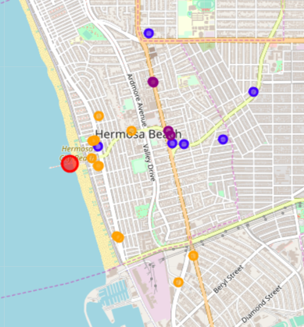
Conclusion
Most of the venues that are closer to the pier are cafes
Traditional coffee shops like Starbucks/Peet’s Coffee are further away from the pier and are closer to the main road and in strip malls
The four available retail spaces are relatively in between
Jane’s observation that there are very coffee shops in such a popular and densely populated area was confirmed using the Foursquare data
With artisanal coffee shops trending in neighboring areas, this could be a great business opportunity for Jane to open up a business in a coffee deprived area!
Red – Hermosa Beach Pier
Blue – Coffee Shops
Orange – Coffee related venues
Purple – Available Retail Leases

